Slide 1
UCSD Embedded Linux Assignment 6
By
Hsuankai Chang
hsuankac@umich.edu

Slide 2
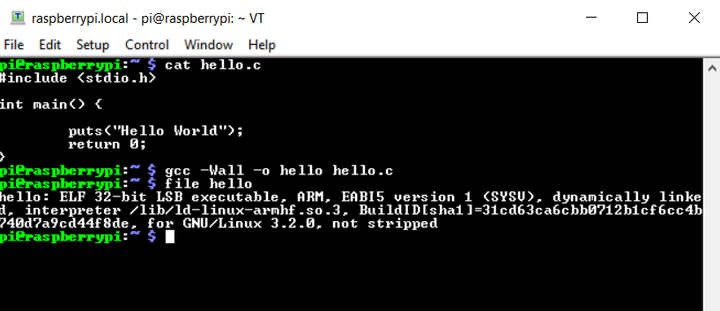
Step 1. Compiling hello.c, host and target

Slide 3
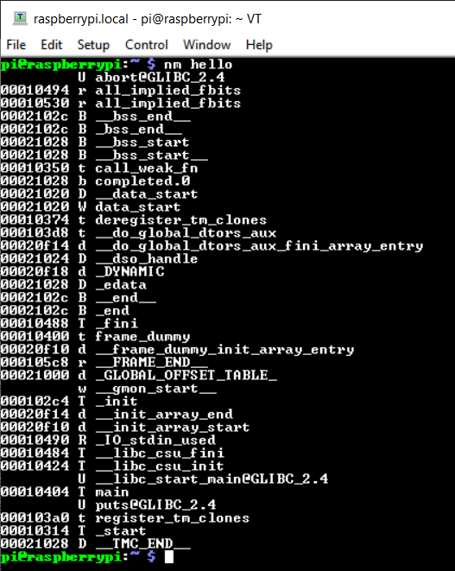
Step 2. Lists symbols from object file – raspberrypi

Slide 4
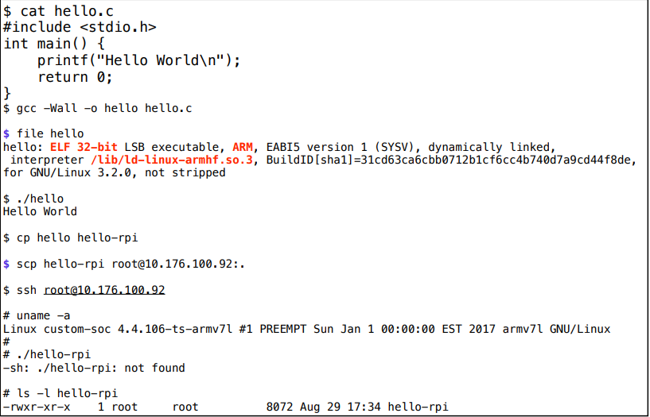
Step 3. Build for RPi/armv7l, move to embedded system and try running. (For the below demo, since I do not have another target running using uclibc, I will just paste the instructor’s file to show I have followed through it.)

Slide 5
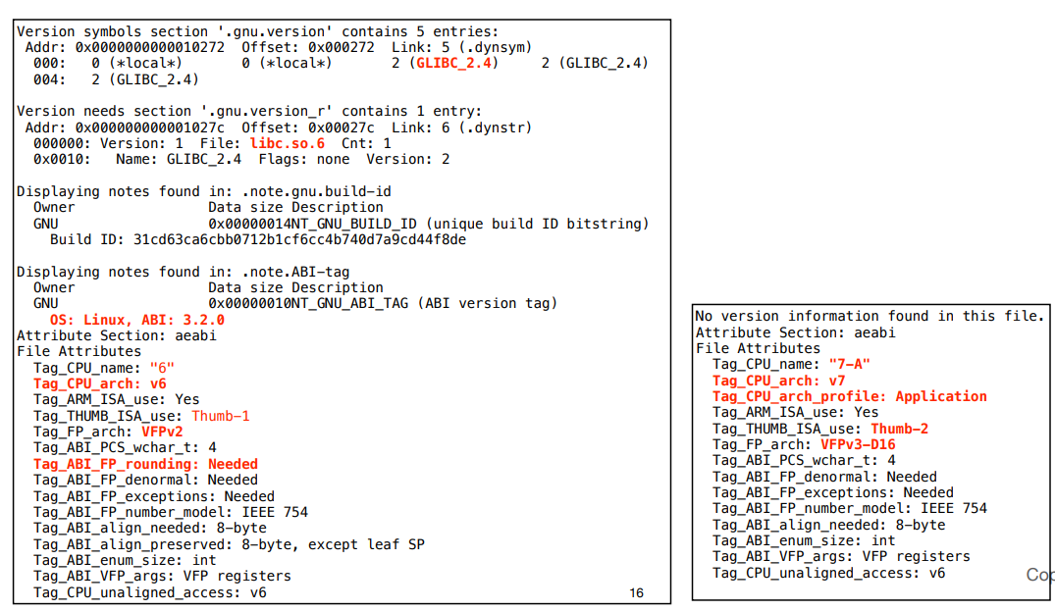
Step 4. readelf (-a for all info)

Slide 6
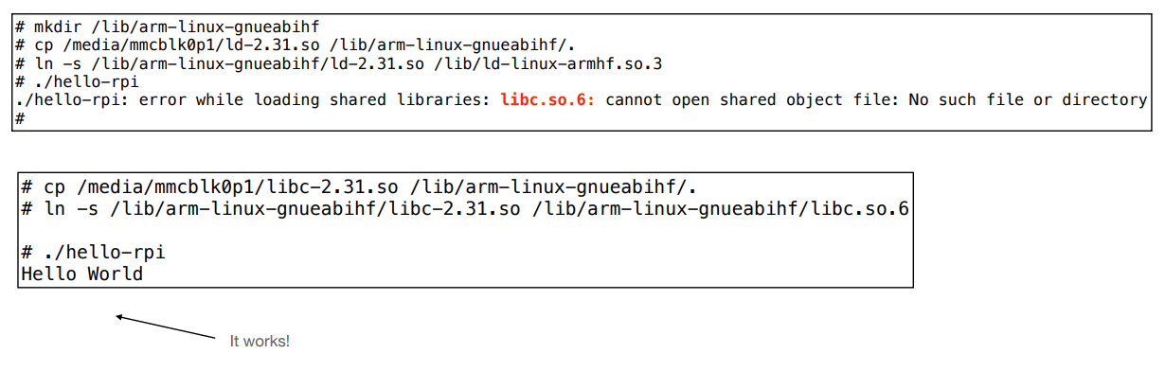
Step 5. Adding RPi files to custom embedded system

Slide 7
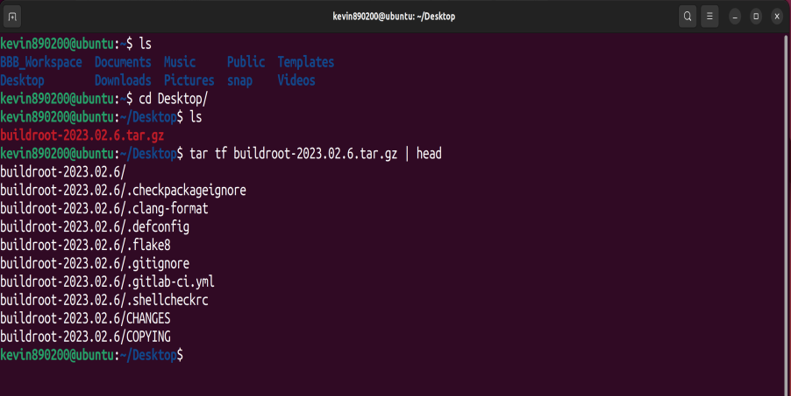
Step 6. Results of Downloading buildroot

Slide 8
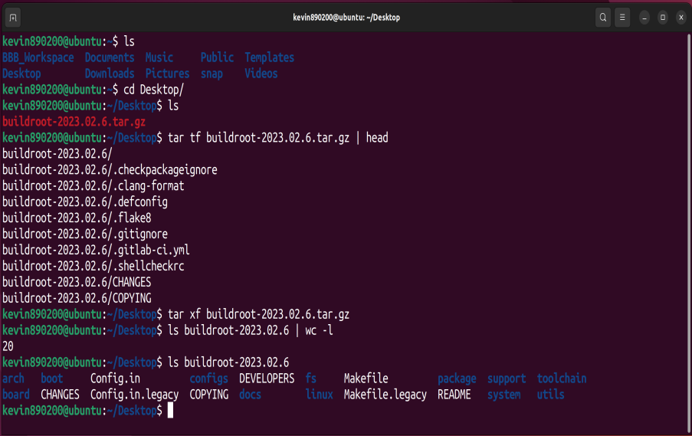
Step 7. Extract tarball

Slide 9
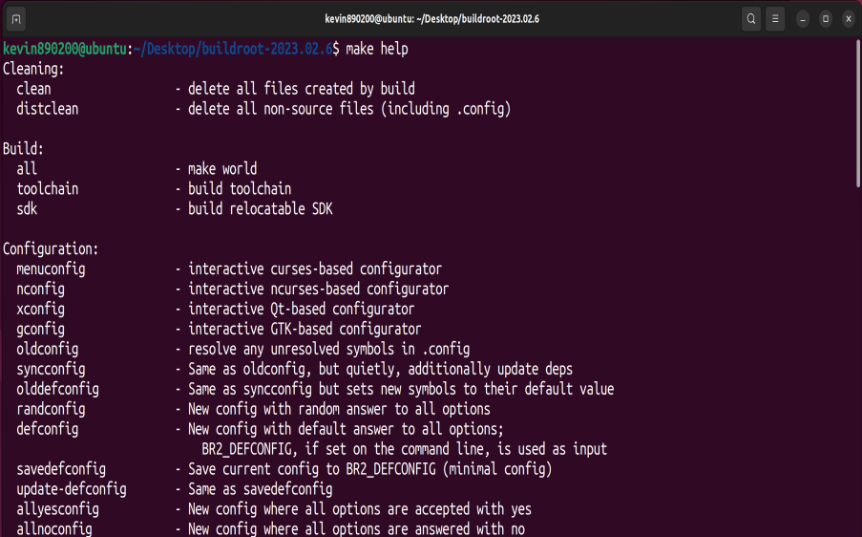
Step 8. Explore make help

Slide 10
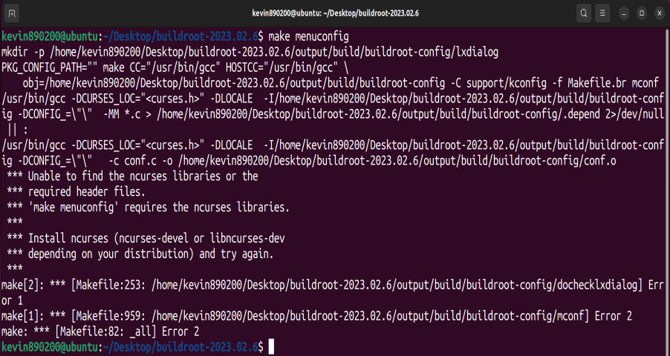
Step 9. make menuconfig attempt

Slide 11
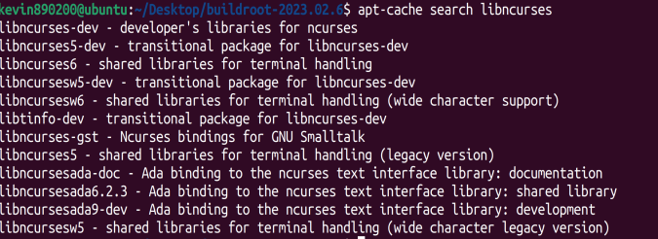
Step 10. apt-cache search libncurses

Slide 12
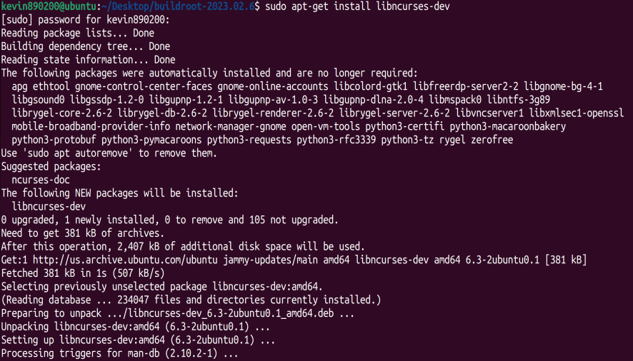
Step 11. sudo apt-get install libncurses-dev

Slide 13
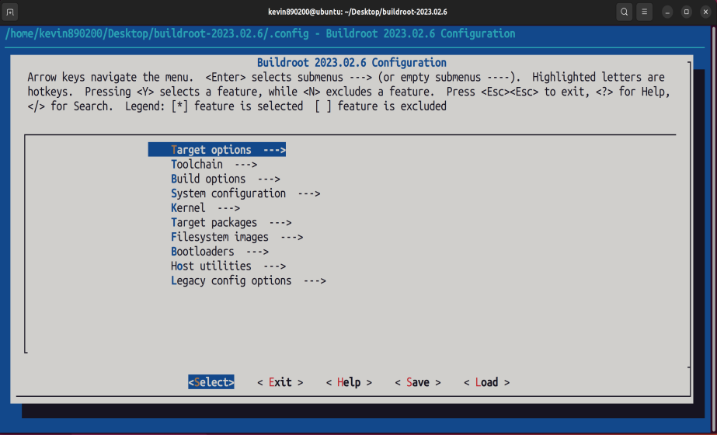
Step 12. make menuconfig works

Slide 14
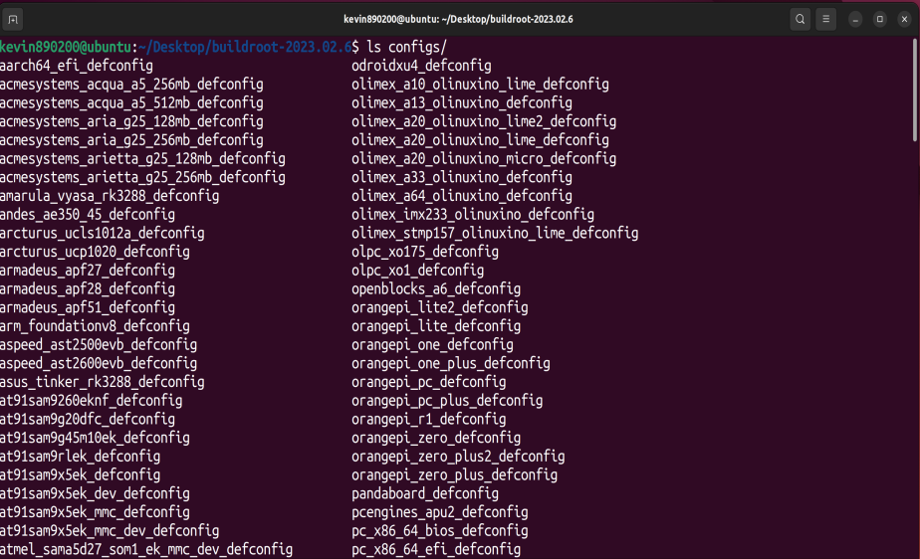
Step 13. Configs Directory

Slide 15
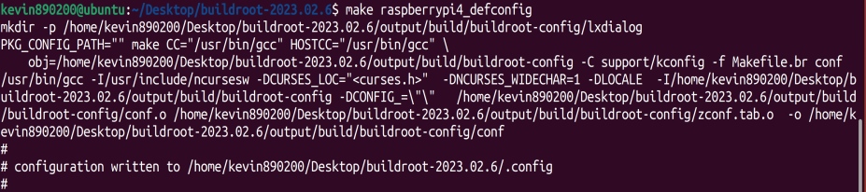
Step 14. make raspberrypi4_defconfig

Slide 16
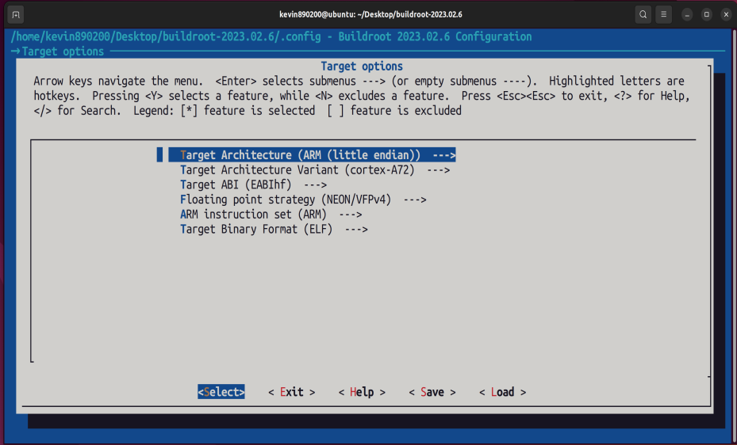
Step 15. Target Options after the config

Slide 17
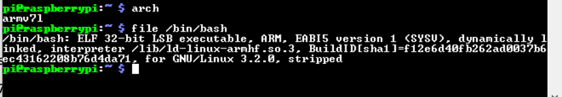
Step 16. Observe default raspberrypi architecture

Slide 18
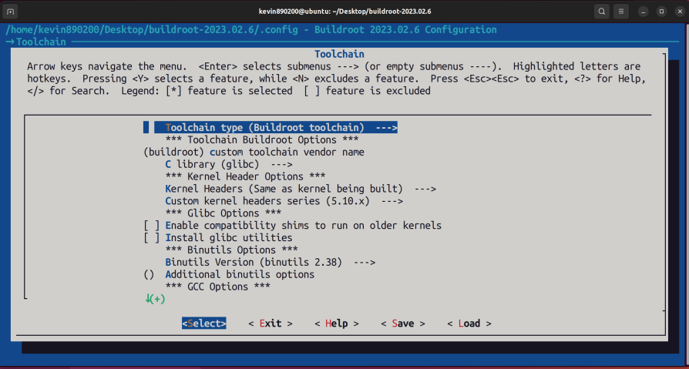
Step 17. Toolchain

Slide 19
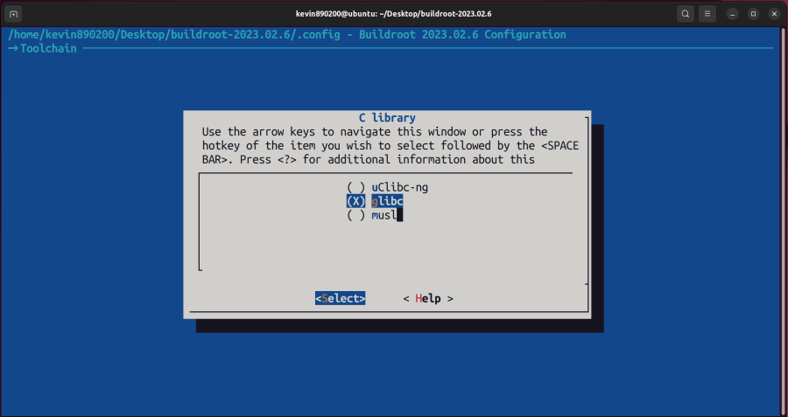
Step 18. C Library

Slide 20
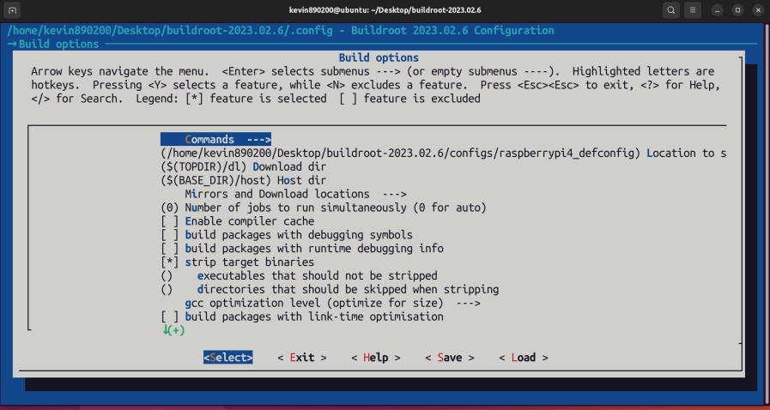
Step 19. Build Options

Slide 21
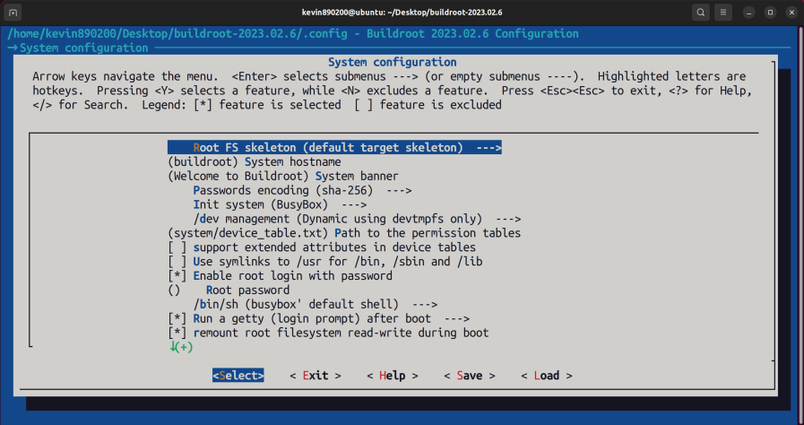
Step 20. System Configuration

Slide 22
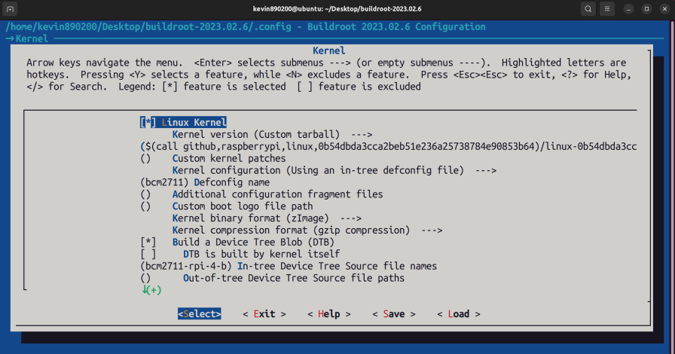
Step 21. Kernel

Slide 23
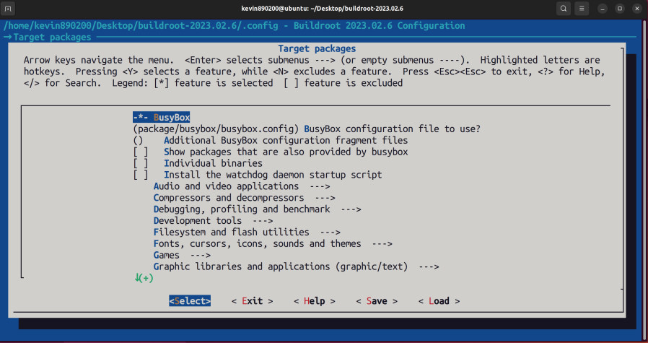
Step 22. Packages

Slide 24
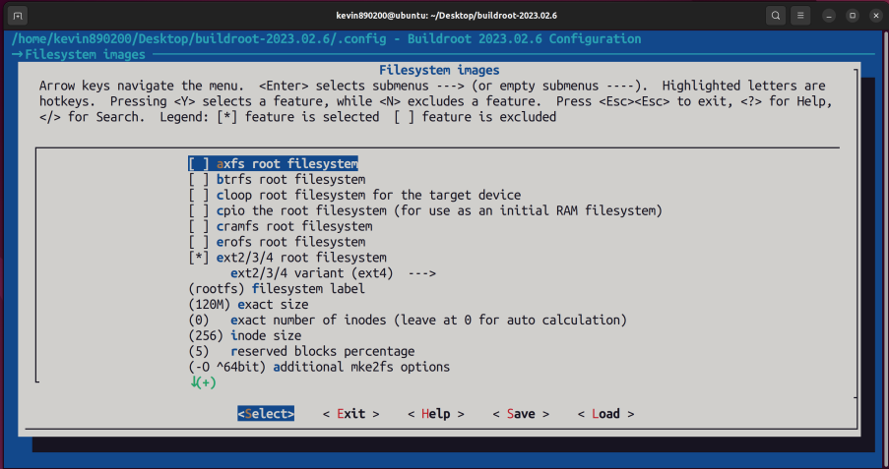
Step 23. Filesystem images

Slide 25
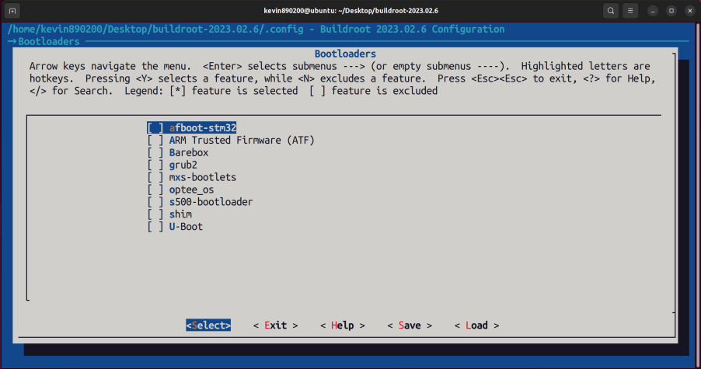
Step 24. Bootloaders

Slide 26
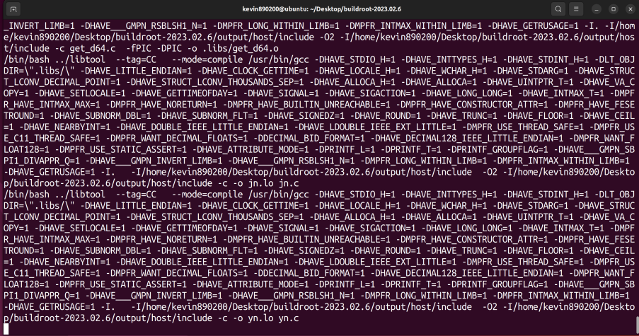
Step 25. Type make to begin build. After some time, my build is successful and not having the errors like instructor faced, maybe because I built on ubuntu linux system, not on raspberrypi directly.

Slide 27
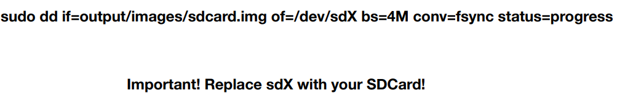
Step 26. After building, copy the image to sd card and boot it up. (I do not have another SD card to test, so just copy the command)

